Slide 1


Yaksha Re-uniting Nature's spirit with love

Slide 2


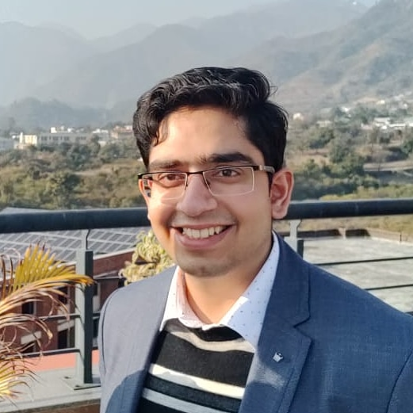

TEAM YAKSHA
Devansu Yadav
Bhavesh Suneja
Namrata Agrawal
Bhavesh Suneja
Kenneth Legaspi
In INDIA IIIrd Year, Bachelors of Technology (B.Tech) in CSE
INDIA
IIIrd Year, Masters of Computer Applications (MCA)
INDIA IVth Year, Bachelors of Technology (B.Tech) in CSE
PHILIPPINES IVth Year, Bachelor of
Science in Computer Science

Slide 3
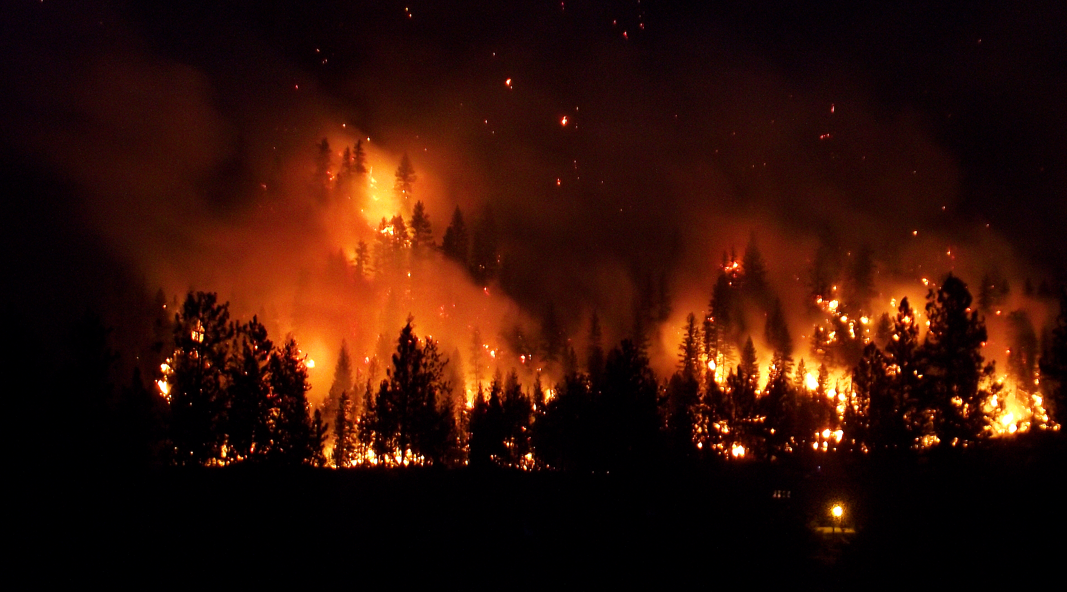
Problems Identified
YAKSHA focuses on two major aspects -
Forest fires detection
Prevention/Mitigation
Forest Fires – Climate change is real
About 4.7 million acres of forest cover were burned in 2019 while there were 8.8 million acres burned in 2018 due to Forest fires.
Out of the total 7,12,249 square km of forest cover, 1,52,421 square km (21.40 percent) is either highly or extremely fire prone. In 2021, India recorded about 21,487 forest fire incidents.
In Philippines, 24KHa of land has burned so far in 2021. This total is low compared to the total for previous years going back to 2001. The most fires recorded in a year was 2005, with 160KHa.

Slide 4

The Solution
Agni Shamak is a Forest Fire detection service that uses IoT and ML to detect forest fire conditions and alert the concerned authorities early on.
It makes predictions about a probable forest fire in a region using data available from the IoT sensors namely Air temp, Humidity, Soil temp, soil moisture and Sunlight sensors.
It also takes appropriate measures to reduce the chances of progression of a forest fire by providing Forest Fire First-Aid (Drone-aided system).

Slide 5

Challenges Faced
Focusing on whether to build a solution to mitigate forest fires in its early stage, or just build a tool predict possible forest fire.
Connecting the IoT Device to Azure IoT Central.
How to mitigate forest fires with the use of drones.
How to develop a machine learning model that makes predictions based on the sensor readings
Dataset on forest fire based on geographical location.
Strategies to prevent early wildfire with Yaksha.

Slide 6

Target Audience
Environment/Social Startup Ventures
Collaborating with startup ventures in the Environment protection space to innovate and scale our product/services.
Government
Providing our services to the Government for a better Forest protection and alerting system.
NGOs
Collaborating with NGOs for installation and maintenance of our solution
Ecological Research centers
Partnering with Research centers to deploy our solution and conduct research

Slide 7
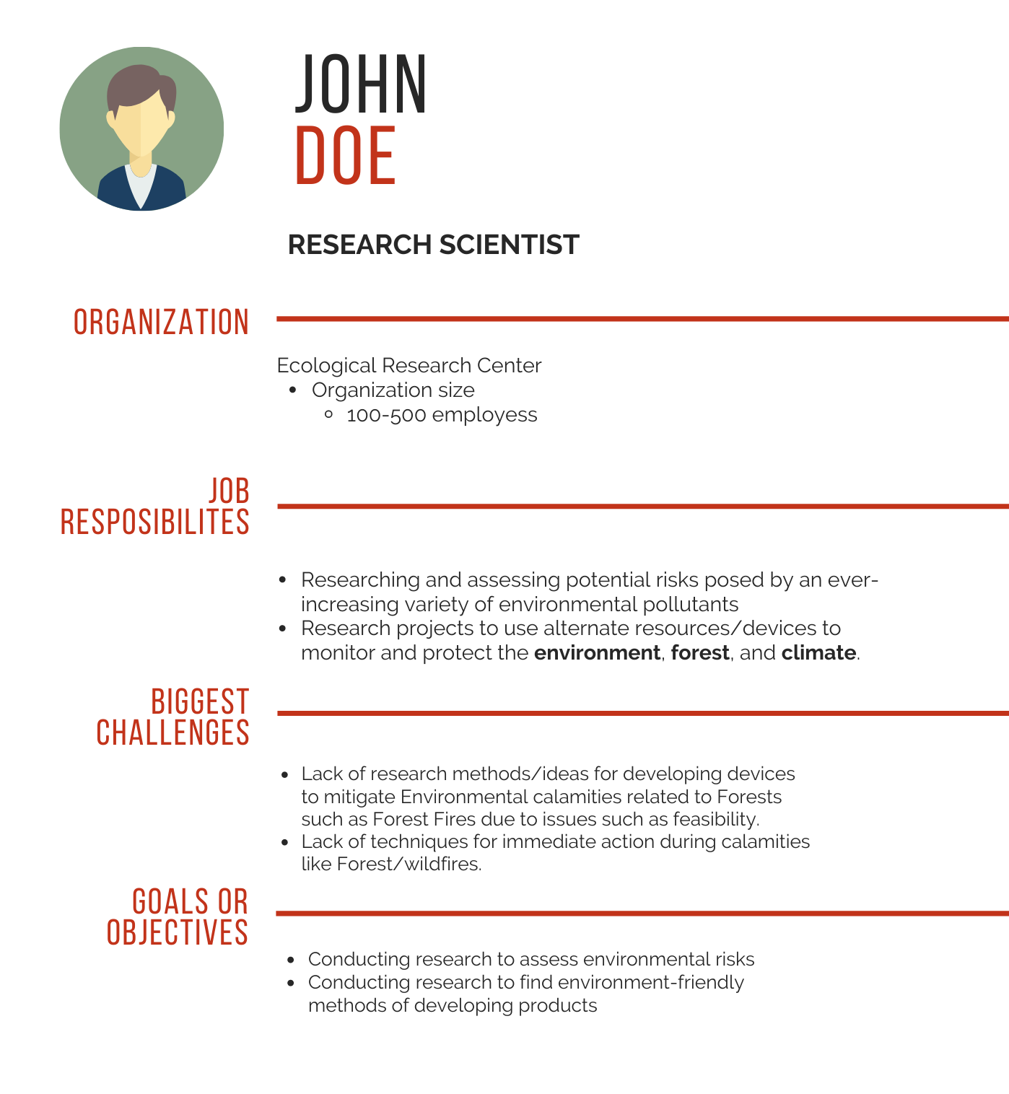
C
U
S
T
O
M
E
R
P
E
R
S
O
N
A
Kenneth
Mehta

Slide 8
The Business Plan
Yaksha
Team Yaksha
31/10/21
1.0
Forest Fires can occur anytime and causes a great loss of Flora and Fauna.
An AIoT based Forest Fire Detection service to detect forest fires early and provide Forest Fire First Aid.
One-of-its-kind Forest Fire First-Aid.(First mover advantage)
Affordable, weather-proof, fire-proof and environment-friendly Yaksha units.
Governments
Ecological Research Centres
NGOs working for the environment
Environmental/Social Start-up Ventures
A nature-spirit, capable of early Forest Fire detection and Forest Fire First-Aid.
Dryad
Umgrauemeio
Ororatech
Number of Yaksha units sold.
A virtual Forest Ranger
Social Media
Email Campaigns
Word of Mouth
Publicity Newspaper
Governments
Ecological Research Centres
Partnerships
Monitoring System subscription fees.
Sale of Yaksha units
Service/Repair Fees
Drone providers, like ideaForge, for Forest Fire First Aid System.
Organic compound manufacturers to make our product fire and weather resistant.
Fixed costs:
Employee salary
Advertisement
Variable Costs:
Office expenses
Equipment costs
Assembling costs
Lean Canvas is adapted from The Business Model Canvas (www.businessmodelgeneration.com/canvas). PowerPoint implementation by: Neos Chronos Limited (https://neoschronos.com). License: CC BY-SA 3.0

Slide 9

Competition Analysis
Competitors
Service
Customers
Orora Tech
Early detection of risk of wildfires from Space
Academia, NGO & Enterprise
Dryad
Monitor & Detect Wildfires using IoT Network
Public Forests & Private owners only
Yaksha
Automatic risk analysis in forest fire detection
Enterprise
Government, NGOs, Ecological Research Centres & Social Ventures.
Deforestation Monitoring and Forest fire Prevention
Umgrauemeio
Deforestation Monitoring
Forest Fire Prevention
Early Wildfire Detection
Eco-friendly
YES
YES
NO
YES
YES
NO
NO
NO, Fire Propagation Analytics only
NO, Reporting actionable information only
NO, Real-time detection & Management Software only
YES
YES, Forest-Fire First Aid
No, High Payload Nano-satellites
NO, Large Scale IoT Sensor Network
YES, Photovoltaic Solar Energy System
YES, Solar Energy based IoT System.

Slide 10
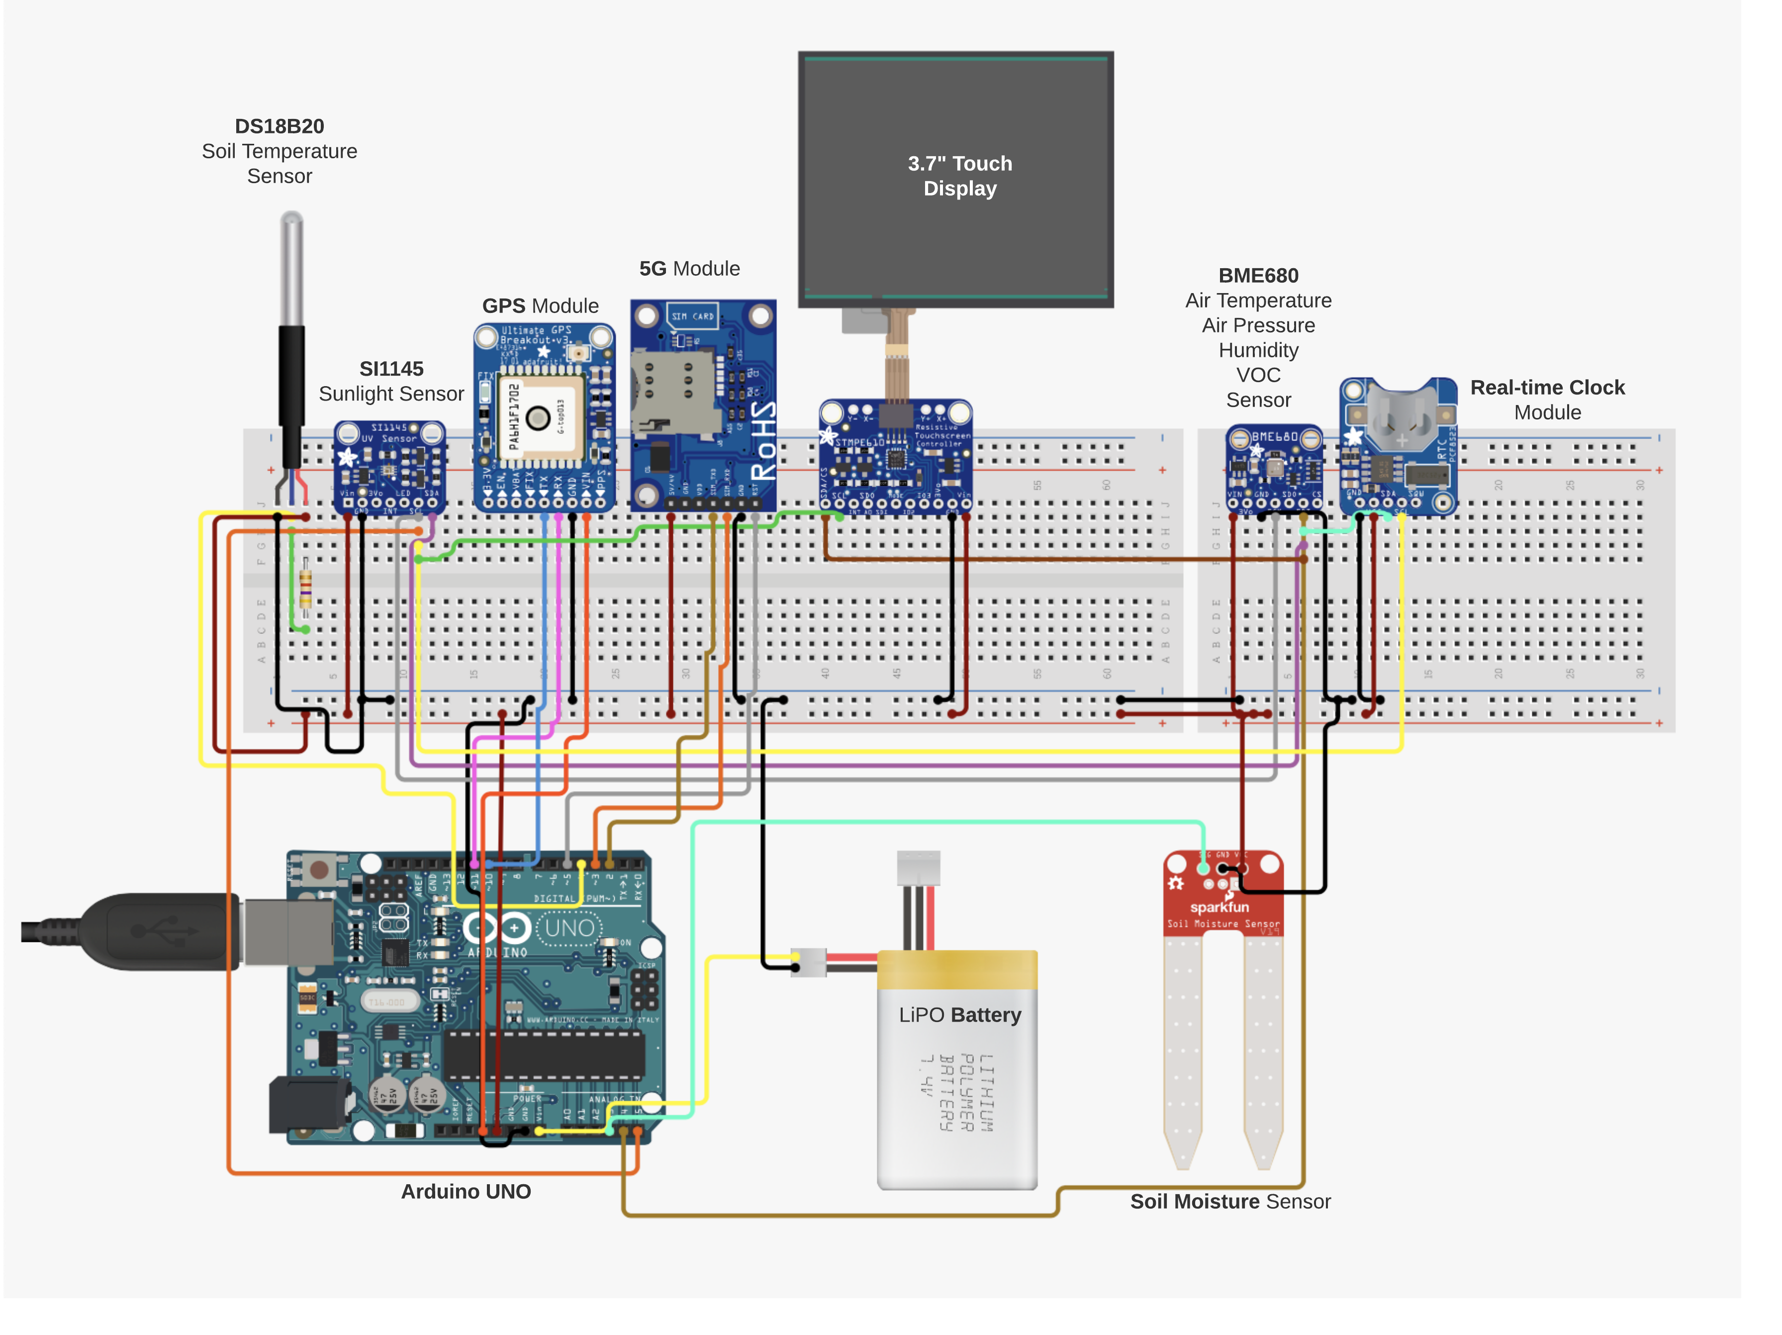
Yaksha
Prototype
(Concept)

Slide 11
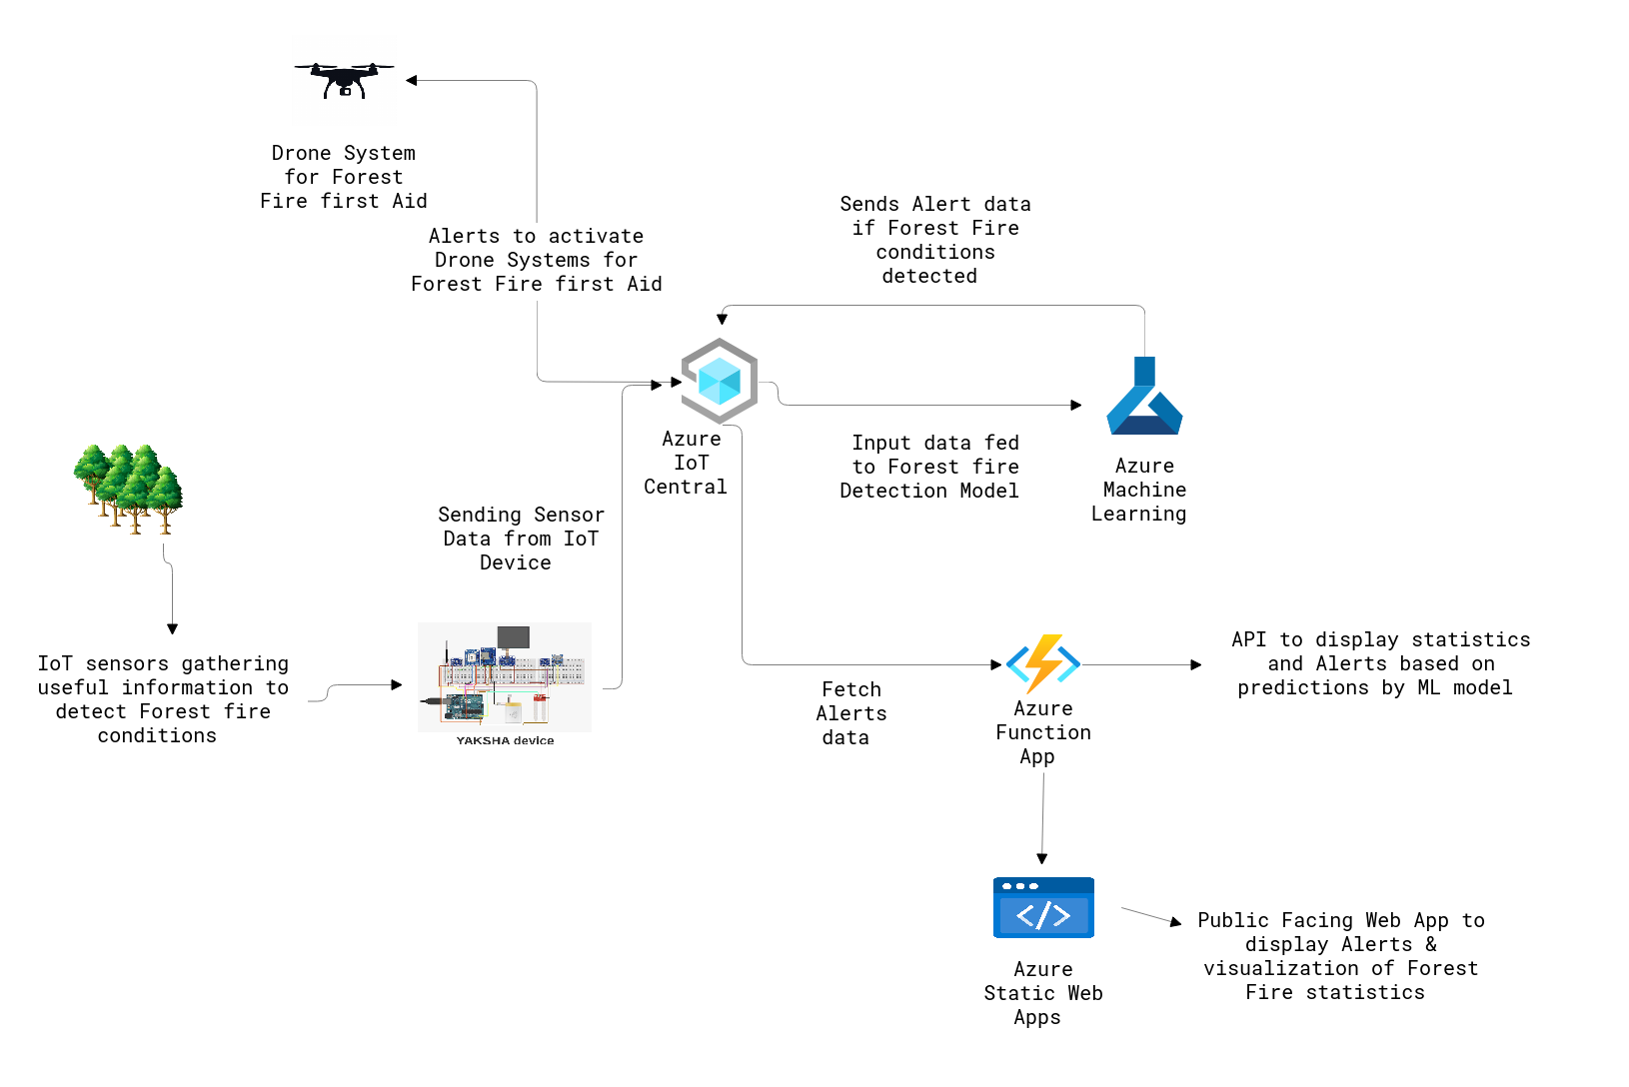
Architecture
Diagram
for
Agni Shamak

Slide 12
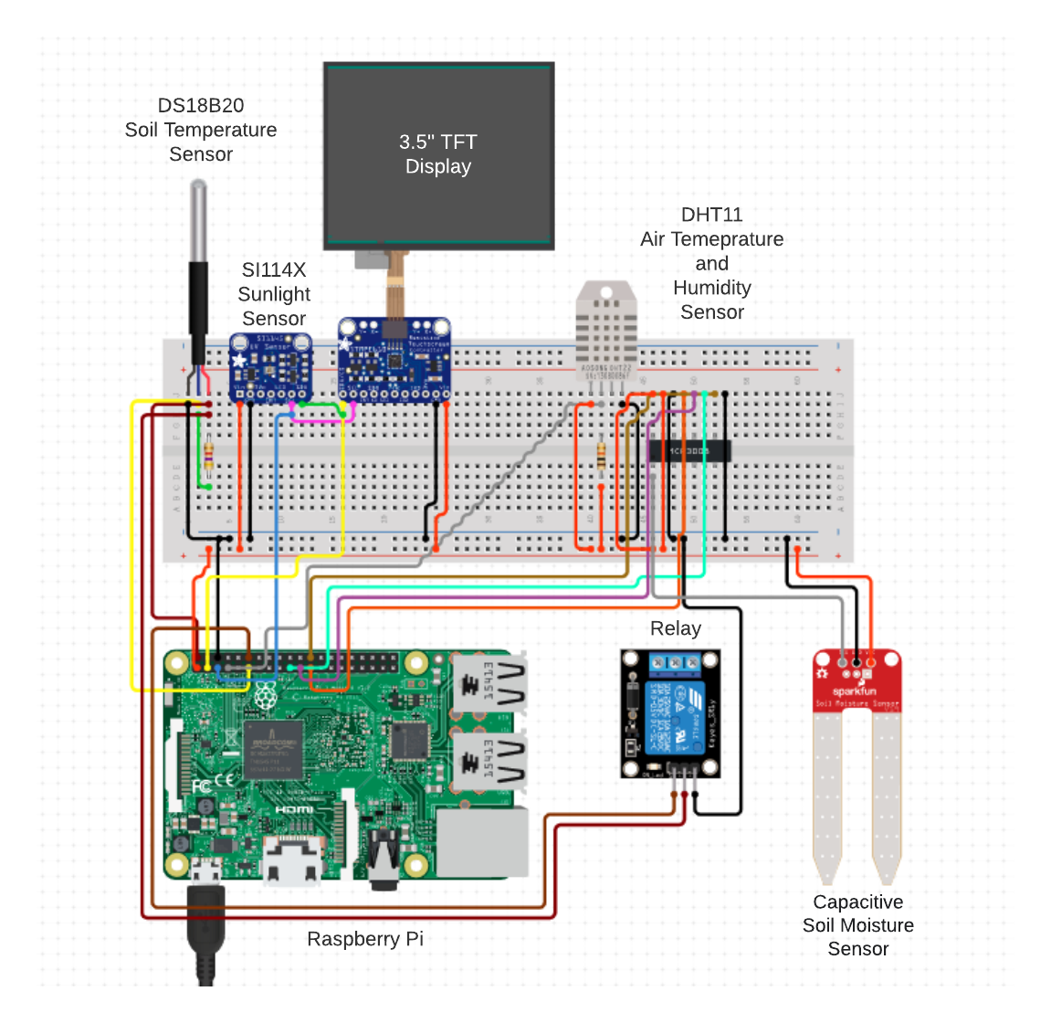
Yaksha
Prototype
Prototype
(Current)

Slide 13
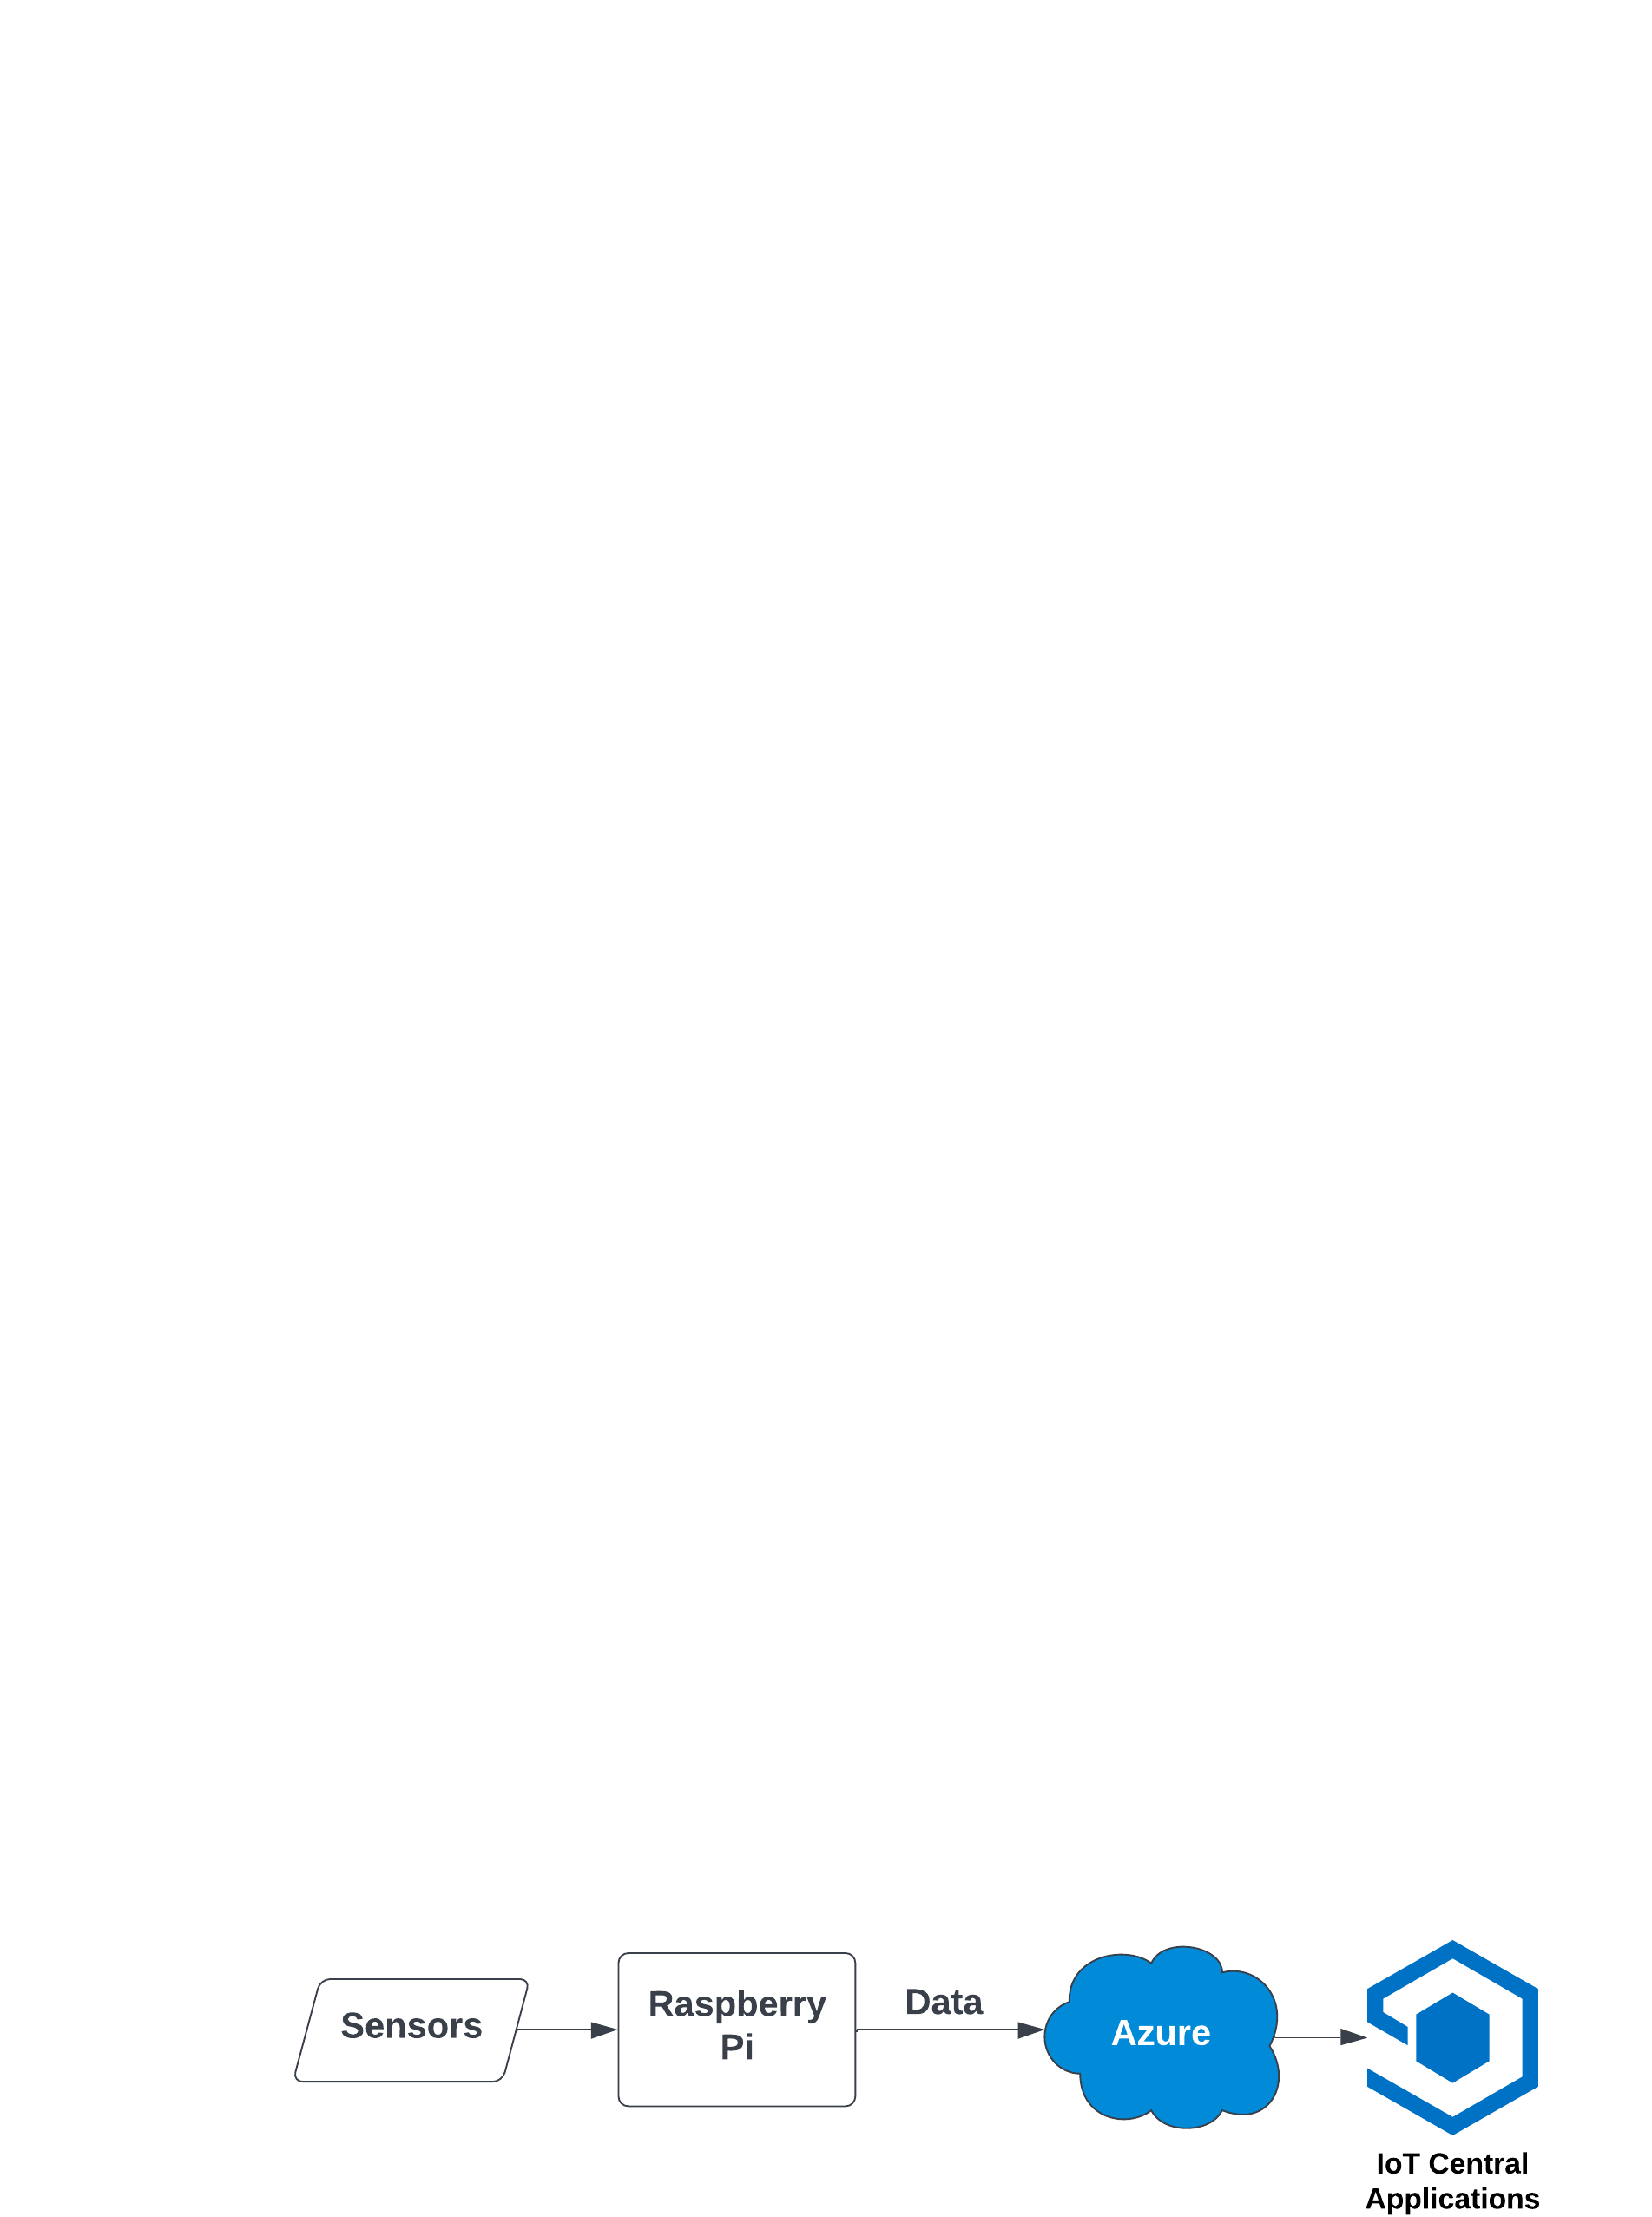
Block
Diagram
Of
Current Prototype

Slide 14
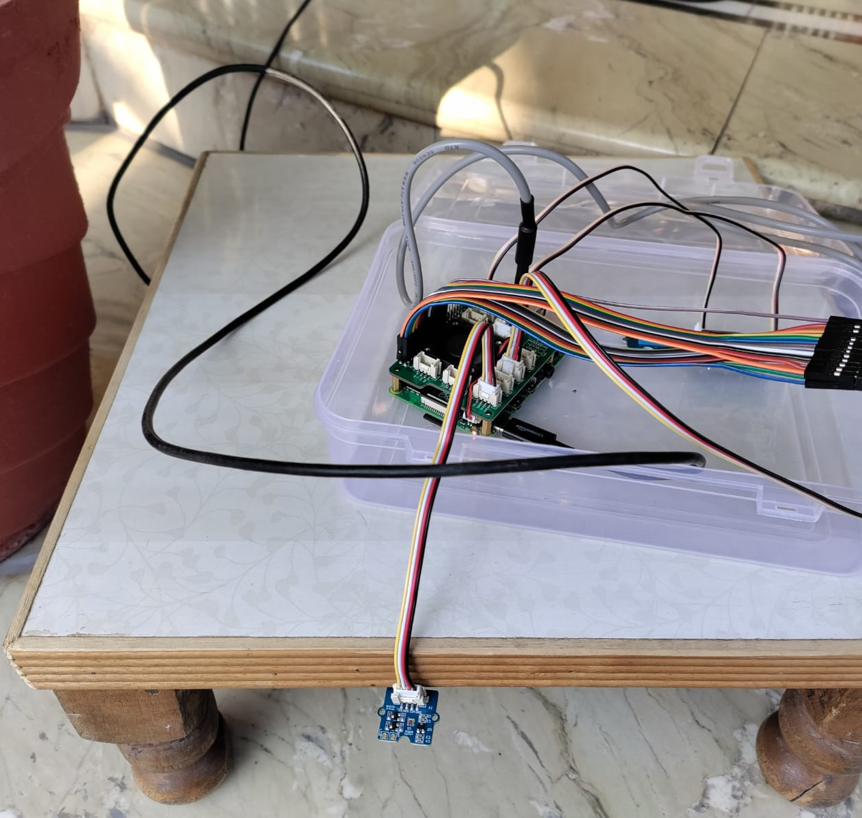
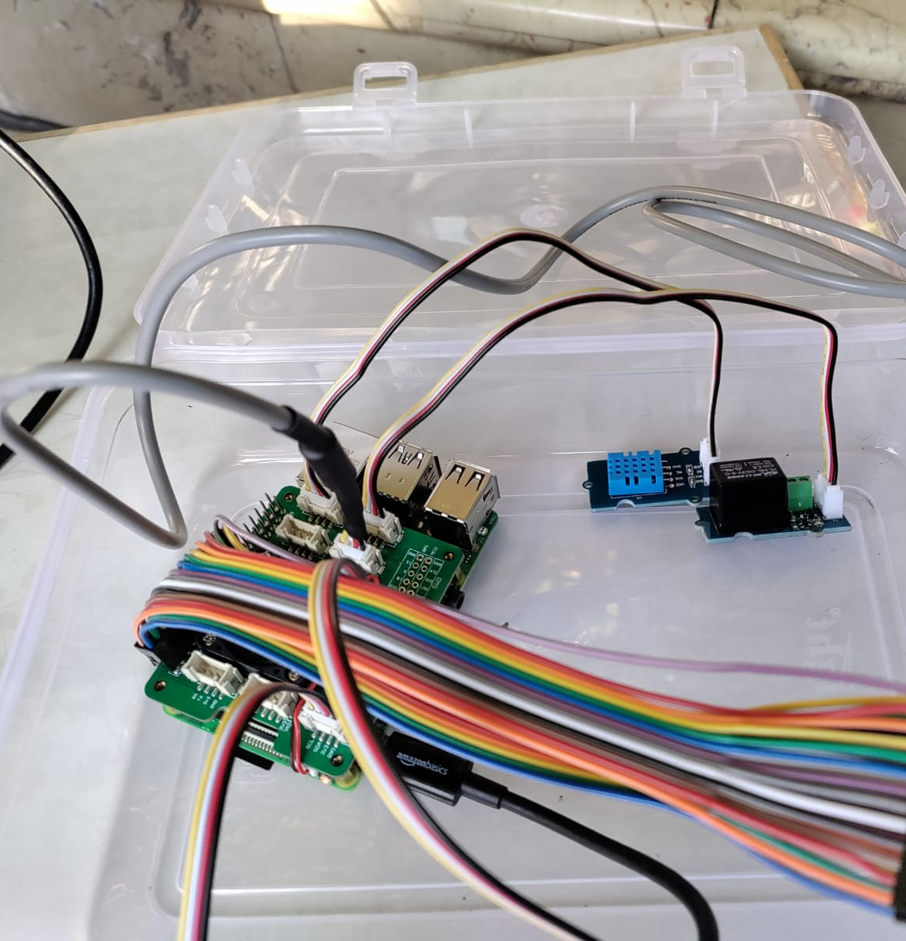
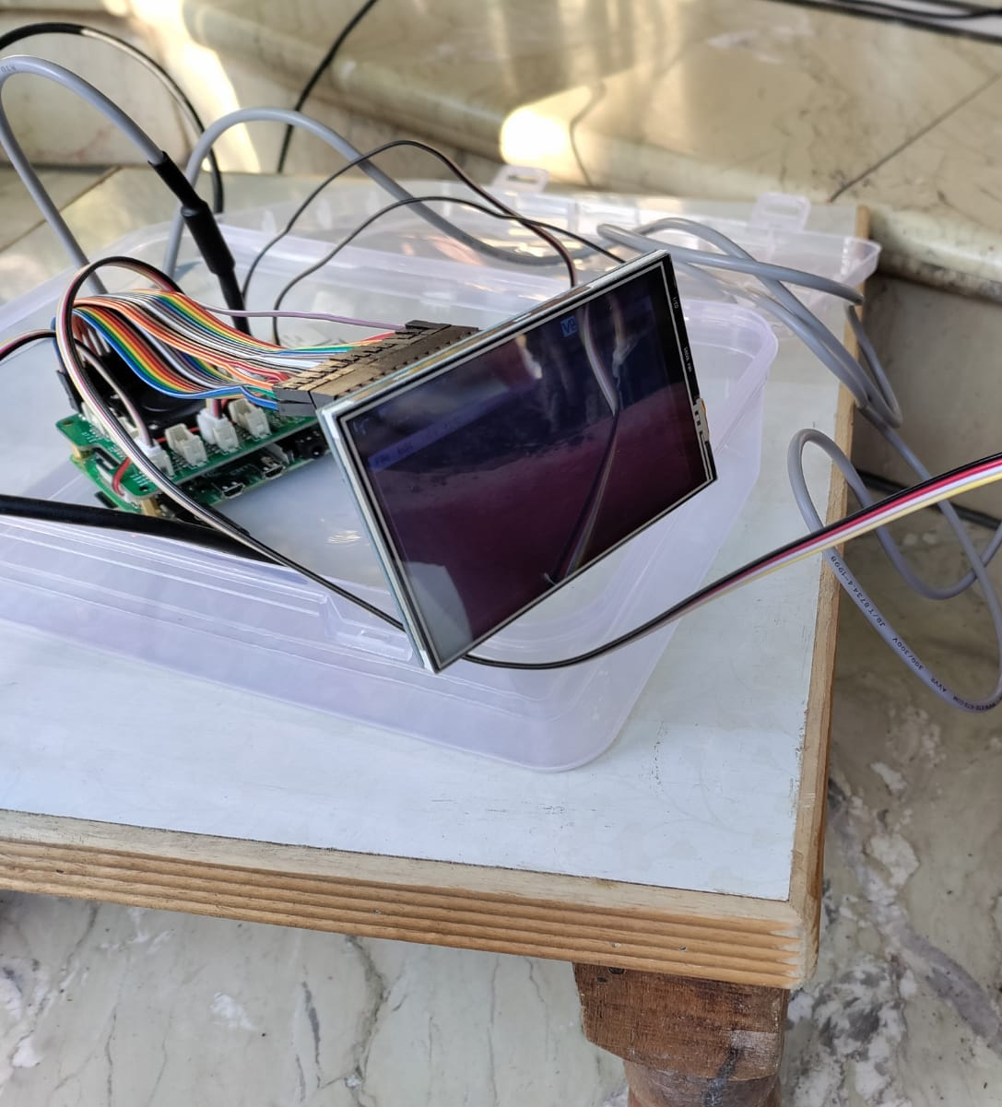
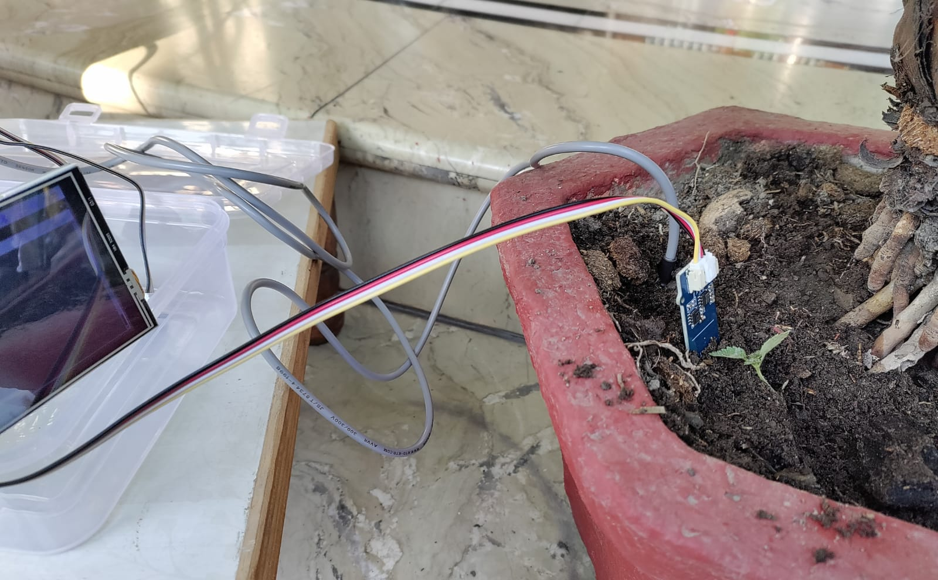
Project Screenshots

Slide 15
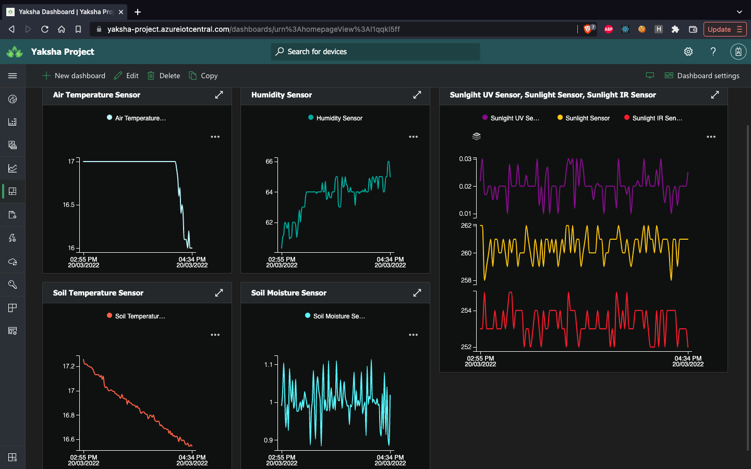
Yaksha Stats Dashboard
(IoT Central)

Slide 16







Add Ingredients with Technology

Slide 17




LIVE IMPACTS
Sustainable development
Cost-effective Forest fire Solution
Prevent Economical damage
Save Human Lives & Wildlife

Slide 18


Thank You
A presentation by
Team Yaksha
GitHub Link

